Slide 1
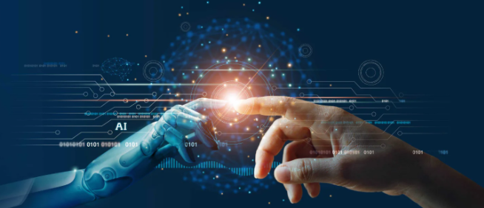
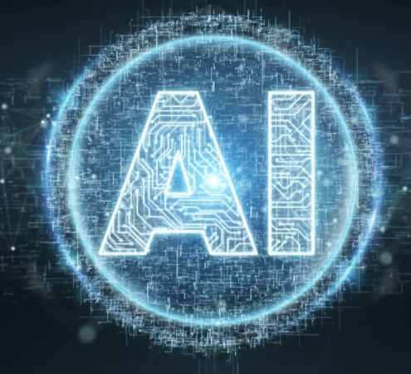
Artificial Intelligence
Course Leader - Dr. Subarna Chatterjee
Topic – AI in Healthcare
Bharath Kumar B – 18ETCS002032
Charith Kumar S – 18ETCS002039
Deepak R – 18ETCS002041

Slide 2
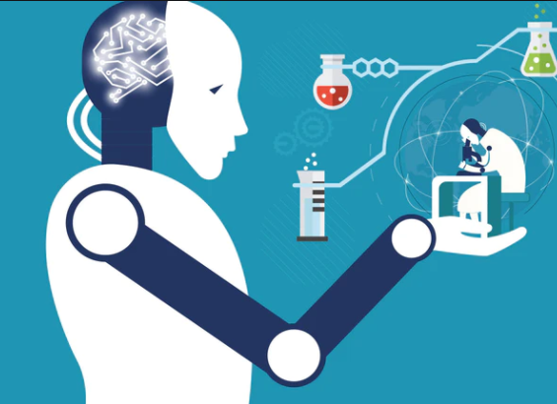
Artificial Intelligence (AI) is one of the leading research fields in the present World of Data Science. Besides all applications, AI has become a part of our personal lives.
Recent developments in Deep Learning approaches and advancements in technology have tremendously increased the capabilities of visual recognition systems.
As a result, AI has been rapidly adopted by Industry where successful use-cases of AI can be seen across the sectors leading to widening the applications and increased demand for AI tools.
In this Assignment we have selected one of the essential and required field to the mankind i.e., Healthcare field where the Artificial Intelligence is been adopted to get the fast, accurate and valid diagnosis and help doctors to cure their patients fast at the early stage with ease.
Artificial intelligence in healthcare, known also as Deep Medicine, is an overarching term used to describe the use of machine-learning algorithms and software, or artificial intelligence (AI), to mimic human cognition in the analysis, presentation, and comprehension of complex medical and health care data.
In healthcare AI is used in Detection, Diagnosis, Prediction, Drug discovery, Personalized medicine, Medical Imaging, Genomics, Cancer research, Brain tumors, Dermatology, Mental health, Speech pattern, Diabetes, Radiology and many more.

Slide 3
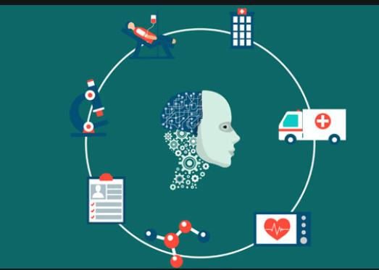
AI background in healthcare:-
AI in medicine even goes back to 1964 with Eliza, the very first chatbot, which was a conversational tool that recreated the conversation between a psychotherapist and a patient. That also was the early days of applying artificial intelligence and rules-based systems on the interaction between patients and their caregivers. Clinical informatics databases and medical record systems were also first developed during this time by AI. A “backward chaining” AI system, MYCIN, was developed in the early 1970s. Based on patient information input by physicians and a knowledge base of about 600 rules, MYCIN could provide a list of potential bacterial pathogens and then recommend antibiotic treatment options adjusted appropriately for a patient’s body weight. MYCIN.11 INTERNIST-1 was later developed using the same framework as EMYCIN and a larger medical knowledge base to assist the primary care physician in diagnosis.
In 1986, DXplain, a decision support system of machine learning (ML) uses inputted symptoms to generate a differential diagnosis. It also serves as an electronic medical textbook, providing detailed descriptions of diseases and additional references. DXplain was able to provide information on over 2400 diseases. By the late 1990s, interest in Machine Learning was renewed, in the medical world by this.

Slide 4
Objectives
The main objective of using artificial intelligence in the field of healthcare is to determine the success rate of prevention and cure procedures for a given disorder, disease or any other medical condition.
AI aims at developing an algorithm based on the outcomes of treatments, diagnosis patterns, development of personalized medicine, drug development and various other medical procedures.
AI systems wants to take responsibility for routine and less risky diagnostic and treatment processes. The aim of AI here is not to replace human clinicians but enable a streamlined high-quality healthcare delivery process.
AI systems aims to get more trained and consequently intelligent; it is foreseeable that these agents replace some of, but not all, the human elements of clinical care.
Robotic assistants have already been employed to conduct surgeries, deliver medication and monitor hospital patients but in future AI’s objective is to for their use is in elderly care and with advances in AI and robotics, the employment of robotic assistants in elderly care is the main objective.

Slide 5
AI role in identifying Metastatic Breast Cancer
Concept and methods used: Deep Learning, Computer Vision, Pattern Recognition, Image Pre-processing
Dataset and Evaluation Metris followed: Camelyon16 dataset consists of a total of 400 whole slide images (WSIs) split into 270 for training and 130 for testing. Slide-based Evaluation (based on performance at discriminating between slides containing metastasis and normal slides)and Lesion-based Evaluation (based on probability and a corresponding (x, y) location for each predicted cancer lesion within the WSI. Measured performance as the average sensitivity for detecting all true cancer lesions in a WSI across 6 false positive rates) are used to evaluate results.

Slide 6
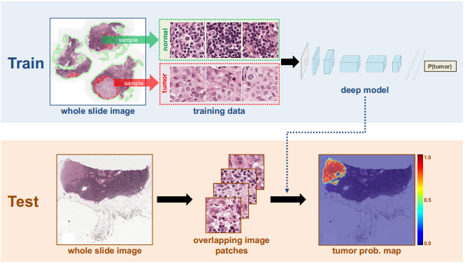
Figure 1 represents the framework and steps used for cancer metastases detection.
Here the patch-based classification stage takes as input whole slide images and the ground truth image annotation, indicating the locations of regions of each WSI containing metastatic cancer. The extracts of millions of small positive and negative patches from the set of training WSIs. If the small patch is located in a tumor region, it is a tumor / positive patch and labeled with 1, otherwise, it is a normal / negative patch and labeled with 0. Following selection of positive and negative training examples, we train a supervised classification model to discriminate between these two classes of patches, and we embed all the prediction results into a heatmap image. In the heatmap-based post-processing stage, we use the tumor probability heatmap to compute the slide-based evaluation and lesion-based evaluation scores for each WSI.

Slide 7
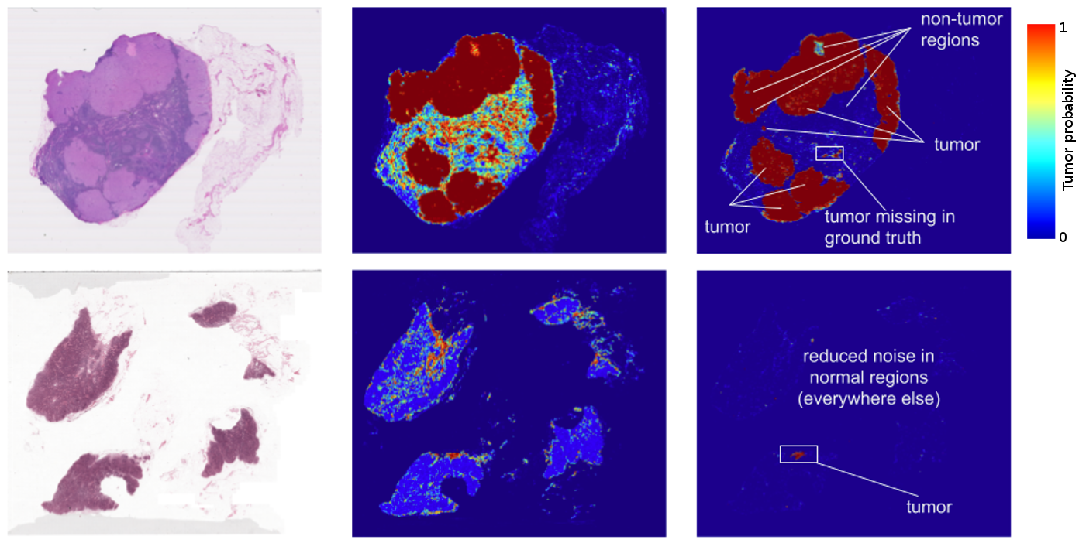
Figure 2 represents the Deep Learning technique for Identifying Metastatic Breast Cancer, the image shows the comparative analysis of detecting the probability of detecting the cancer.
Here the challenge is to evaluate computational systems for the automated detection of metastatic breast cancer in whole slide images of sentinel lymph node biopsies. Obtaining an area under the receiver operating curve (AUC) of 0.925 for the task of whole slide image classification and a score of 0.7051 for the tumor localization task. A pathologist independently reviewed the same images, obtaining a whole slide image classification AUC of 0.966 and a tumor localization score of 0.733. Combining deep learning system's predictions with the human pathologist's diagnoses increased the pathologist's AUC to 0.995, representing an approximately 85 percent reduction in human error rate. These results demonstrate the power of using deep learning to produce significant improvements in the accuracy of pathological diagnoses.

Slide 8
AI role in Medical Diagnostic Systems
Diagnosis has been defined as the method of identifying a disease from its signs and symptoms to conclude its pathology. Diagnosis can also be defined as the method of figuring out which disease is based on an individual’s symptoms and signs. The data gathered from medical history physical examination of the individual having medical pathology constitutes the knowledge required for diagnosis.
Classification of diseases depending upon various parameters is a complex task for human experts but AI would help to detect and handle such kinds of cases. Currently, various AI techniques have been used in the field of medicine to accurately diagnosis sicknesses.
Steps for the diagnosis process are: The Medical History -> Physical examination ->Performing Diagnosis tests -> Drawing conclusions

Slide 9
Fuzzy logic process for Disease Diagnosis
Fuzzy logic provides dynamic methods that deal with difficult problems. Fuzzy logic is assumed to be a solid tool for decision-making systems, such as expert systems or Pattern classification systems. These frameworks give an outcome depending on the knowledgebase incorporated within or from specialists or experts in the field. Various clinical diagnoses systems created depend on the fuzzy set model and applied in the medical field.
Fuzzy logic steps for disease diagnosis: • Fuzzifier: The Fuzzification process is done by a Fuzzifier. It is a process of changing a crisp input value to the fuzzy set. Hence Fuzzifier is used as a mapping from observing input to fuzzy value. • Inference engine: After completing the fuzzification process, fuzzy value processed by the inference engine using a set of rules act as a collection of rules to the knowledge base. • Knowledgebase: This is the main component of the fuzzy logic system. The overall fuzzy system depends on the knowledge base. Basically, it consists of rules, structured and unstructured data also named the database. • Defuzzifier: The process of converting the output from the inference engine into crisp logic. Fuzzy value is an input to the defuzzification that maps fuzzy value to crisp value.

Slide 10
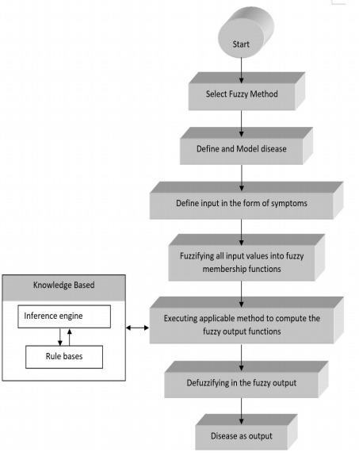
Figure 3 represents the Fuzzy logic method or procedure in AI to diagnosis a disease.

Slide 11
There are also other methods in AI like machine learning and deep learning methods other than fuzzy logic to diagnosis a disease.
The steps followed in the machine learning process to diagnosis disease is :
1) Collect test data with patient details.
2) The feature extraction process picks attributes which are useful for disease prediction.
3) Afterward, the selection of attributes, then select and process the dataset.
4) Various classifications methods as mentioned in the diagram can be applied to preprocess dataset to evaluate the accuracy of prediction of disease.
5) The performance of different classifiers compared with each other in order to select the best classifier with the highest accuracy.

Slide 12
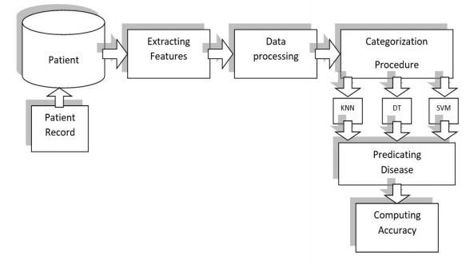
Figure 4 represents the Machine learning method or procedure in AI to diagnosis a disease.
In Machine learning, all the features extracted by a domain specialist to minimize the complications of data and to develop patterns in such a way that would easily visible to ML algorithms. However, deep learning based technique can extract features manually without human intervention, the only condition is to make precise decisions in which the testing data could be accurate. This technique eliminates the requirement of a domain expert for feature extraction. And this is the main difference between the machine learning and deep learning methods in diagnosing a disease.

Slide 13
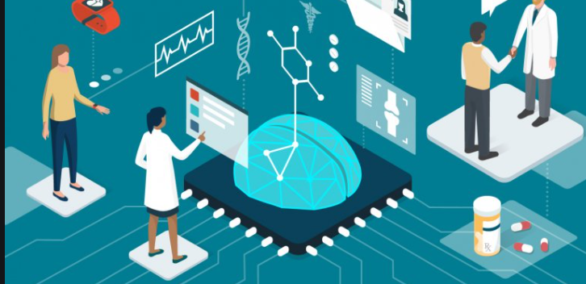
Conclusion and Recommendation
Healthcare AI startups are quickly growing. More than 300 startups have emerged since 2016, and a record 77 first equity deals were made just last year.
AI can undoubtedly bring new efficiencies and quality to healthcare outcomes in India.
However, gaps and challenges in the healthcare sector reflect deep-rooted issues around inadequate funding, weak regulation, insufficient healthcare infrastructure, and deeply embedded socio-cultural practices. These cannot be addressed by AI solutions alone.
Moreover, technological possibility cannot be equated to adoption.
In India, poor digital infrastructure, a large, diverse and unregulated private sector, and variable capacity among states and medical professionals alike, mean that the adoption of AI is likely to be slow and deeply heterogeneous.
The same factors also make it quite likely that well-established private hospitals will be the main adopters. This in turn would imply that much of the dominant narrative or rationale for the development of AI in healthcare, in terms of improving equity and quality, is unlikely to be addressed through market forces alone:
these solutions are more likely to serve populations who already have access to high-quality care, typically in cities with well-developed digital infrastructure.
In many small hospitals and single-provider practices in India, administrative systems have barely moved beyond rudimentary ICT solutions such as invoicing and billing platforms.

Slide 14
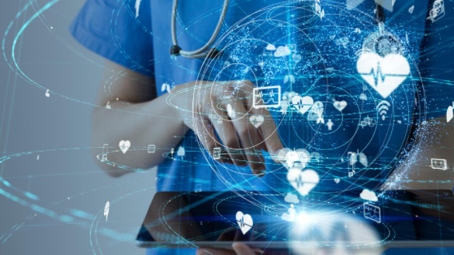
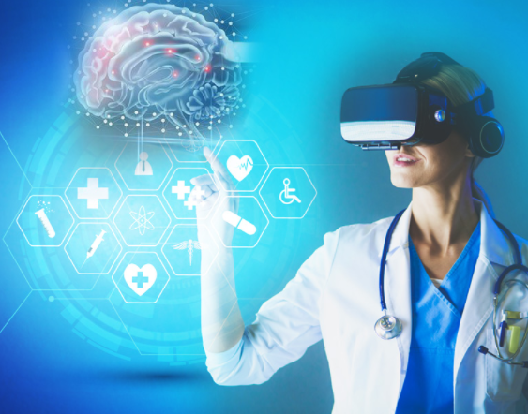
The effectiveness of these systems will depend on accurate identification of problems and their matching to appropriate solutions.
Currently, there is a risk that solutions are technology-led rather than problem-led, and they are as a result often blind to specific contextual needs or constraints.
For example, it might not be the best approach to design real-time or synchronous solutions for digital products meant to be used in remote areas where basic internet infrastructure is lacking.
Designing the right digital interventions is often challenging because of the digital divide between the user and the technology developers, who are typically more adept at using technology than the user is.
Finally, issues around privacy, misuse and accountability are only slowly being understood, and require much more far-reaching consideration before AI can deliver safe and fair healthcare solutions.

Slide 15

